Slide 1


The art of yield
EuroPython 2025
Avoid return values in your codebase
Maxim Danilov

Slide 2

Who I am
Maxim Danilov
Python and Django developer for backends
Lover of reactive frontend frameworks
Last year I provided >6,600 minutes of Mentoring sessions for python developers.

Slide 3
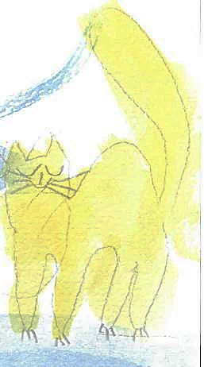



Special thanks to my family for the support:
cat
Kisa
daughter Maja
son
Mark
dog
Marselle
my wife
Elena

Slide 4


Thanks to my children for the illustrations

Slide 5

Why not to use return
In large distributed Python codebases, debugging unexpected side-effects takes much more time than testing returned values.

Slide 6






My reasons to avoid return.
Clarifying
Explicit events and intentional state changes
Readability
The code declares what it does
Decoupling
Code not affected by the return value.
Testability
Testing the events and state changes
Concurrency
Don’t need to await a returning value
Unconventionality
New solutions expand experience

Slide 7

return statement
Language basics & pitfalls

Slide 8

return
Basis syntax of python language
Python always return value from function/method
If return is omitted – python adds return None.

Slide 9

return value VS return None
return value
skip return or return None
def ret_value(a,b):
e = a + b
return e
…
LOAD_FAST 2 (e)
RETURN_VALUE
def without(a,b):
e = a + b
# return None
…
POP_TOP
RETURN_CONST 0 (None)

Slide 10

in generators return is not always return:
def test(*value):
yield sum(value)
return value
def test(*value):
yield sum(value)
raise StopIteration(value)
PEP 380
«return value» is semantically equal to «raise StopIteration(value)»
PEP 479
All StopIteration are equal, but some StopIteration are more equal than others.
> StopIteration:value
> RuntimeError: StopIteration:value

Slide 11


More criticism of PEP 479
In my talk „What are you yield from” on PyCon IT 2023

Slide 12

Summary for explicit return statement:
We can avoid using return, but it is not a rule
return with inline computation are mostly efficient
In c-python, return None not optimized
return is not always what it seems

Slide 13

Captain Obvious, how to avoid return?
Don’t use return statement in your codebase.
Get data from methods by any other legal mechanism.
Explore alternative data-flow strategies.

Slide 14

Don’t use return in your code
If framework allows it.
Notes:
We can still use return if complexity grows unexpectable.

Slide 15

Some frameworks allow skip return
class ArticleDetailResponse(DetailView.response_class):
def __init__(self, *args, context=None, **kwargs):
context["now"] = now()
super().init(*args, context=context, **kwargs)
class ArticleDetailView(DetailView):
model = Article
response_class = ArticleDetailResponse

Slide 16

Some code constructs allow skip return
from contextlib import contextmanager
@contextmanager
def resource(*args, **kwargs):
resource = open("sample.txt") # Code to acquire resource
try:
yield resource # yield used instead of return
finally:
resource.close() # Code to release resource
...
with resource() as source:
lines = source.readlines

Slide 17



Don‘t use return in code with right tools:
The framework can allow to write declarative code
Methods like __init__ don’t have return
Contextmanager help adds the value to the context
Code can be generated at startup from a text specification

Slide 18

return statement not needed
With the Finite-state machine paradigm
Notes:
We can still use return if complexity grows unexpectable.

Slide 19

State, Event, Transition
Yellow
class 🚦 (StateMachine):
🟢 = State(initial=True)
switch = 🟢.to(🟡)
on_enter_🟡 = lambda x: print("🟡 is on") # callback
🚦().send(“switch") # event
Green
on_exit
Red
on_entry
pythonji

Slide 20

State-machine example:

Slide 21
State-machine example:
pythonji
>>> 🐱‍🏍 = MyCuteSuperHero(“SuperCat")
>>> 🐱‍🏍.wake_up()
>>> 🐱‍🏍.rescued
None
>>> 🐱‍🏍.distress_call(voice_stream)
>>> 🐱‍🏍.state
'saving the world’
>>> 🐱‍🏍.complete_mission()
>>> 🐱‍🏍.rescued
🌍

Slide 22

FSM Principles:
States of objects attributes changed in transition
Conditions, based on states, checked on transition
Transition callbacks, called from events
Working with States except through events

Slide 23

If return not needed
Code contains commands what should be done.
More Interfaces present to work with state
In testing, the state-changes are checked.
Event sourcing pattern from Event-Driven Architecture

Slide 24

return-less libraries and frameworks
🚥
pytransitions
python-statemachine
🧩
dry-python/stories
django-service-objects
⚙
ThespianPy
🛠
Django ✔️
📣
Logging
📻
Celery

Slide 25

Any other legal form to get data.
Exception driven design.

Slide 26
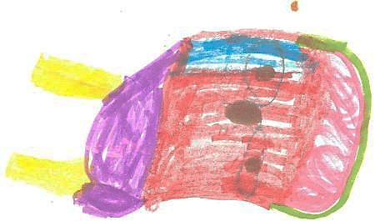
Exception-Result propagation
class Response(Exception):
def __init__(self, result):
self.value = result
def dfs(node, target):
if node.value == target:
raise Response(node) # Fast exit with result. Important in recursions.
for child in node.children:
dfs(child, target)
try: # Unified form of handler for success/error
dfs(root_node, 42)
except Response as response: # A exception is only container for the result
print(“Find:",response.value)

Slide 27

Where used:
Pytest – all functionality based on exceptions
Async coroutines – StopIteration deliver returned value
DFS/BFS, parsing, regex algorythms

Slide 28

Exception instead of return
Used where recusion or multiple call stack happens
A exception is only container for the result, not more
3. More exception-classes present
4. Testing of raised exceptions

Slide 29

Alternative data-flow strategies.
Generators & coroutines.

Slide 30

Coroutine:
def _attr(attr = None):
while True:
val = yield attr
if isinstance(val, tuple):
attr = val[0]
...
coro = _attr()
coro.send(None) #start coroutine
...
next(coro) #read
... coro.send((value,)) #write

Slide 31
Coroutine:
def _attr(attr = None):
while True:
val = yield attr
if isinstance(val, tuple):
attr = val[0]
...
coro = _attr()
coro.send(None) #start coroutine
...
next(coro) #read
... coro.send((value,)) #write

Slide 32
Coroutine:
def _attr(attr = None):
while True:
val = yield attr
if isinstance(val, tuple):
attr = val[0]
...
coro = _attr()
coro.send(None) #start coroutine
...
next(coro) #read
... coro.send((value,)) #write

Slide 33

Coroutine:
def _attr(attr = None):
while True:
val = yield attr
if isinstance(val, tuple):
attr = val[0]
...
coro = _attr()
coro.send(None) #start coroutine
...
next(coro) #read
... coro.send((value,)) #write

Slide 34
Coroutine:
def _attr(attr = None):
while True:
val = yield attr
if isinstance(val, tuple):
attr = val[0]
...
coro = _attr()
coro.send(None) #start coroutine
...
next(coro) #read
... coro.send((value,)) #write

Slide 35
Coroutine:
def _attr(attr = None):
while True:
val = yield attr
if isinstance(val, tuple):
attr = val[0]
...
coro = _attr()
coro.send(None) #start coroutine
...
next(coro) #read
... coro.send((value,)) #write

Slide 36

Coroutine‑backed attribute
class CoroAttribute:
def _attr(self, att = None):
while True:
val = yield attr
if isinstance(val, tuple):
attr = val[0]
attr = property(
lambda self:next(self._attr), # setter
lambda self,val:self._attr.send((val, )) #getter
)

Slide 37
Coroutine‑backed attribute
class CoroAttribute:
def _attr(self, att = None):
while True:
val = yield attr
if isinstance(val, tuple):
attr = val[0]
attr = property(
lambda self:next(self._attr), # setter
lambda self,val:self._attr.send((val, )) #getter
)

Slide 38

Coroutine‑backed attribute (read & write)
class CoroAttribute:
def __init__(self, attr=None):
#start coroutine
self._attr = self._attr(attr)
self.attr
... #read
CoroAttribute().attr
... #write
CoroAttribute().attr = value

Slide 39
Coroutine‑backed attribute (read & write)
class CoroAttribute:
def __init__(self, attr=None):
#start coroutine
self._attr = self._attr()
self._attr(attr)
... #read
CoroAttribute().attr
... #write
CoroAttribute().attr = value

Slide 40
Coroutine‑backed attribute (read & write)
class CoroAttribute:
def __init__(self, attr=None):
#start coroutine
self._attr = self._attr()
self._attr(attr)
... #read
CoroAttribute().attr
... #write
CoroAttribute().attr = value

Slide 41

Coroutine based attribute:
Unified “gate” for reads and writes We can add validation, permission checks, logging, etc.
Really protected and cached Internal value not changeable without using interface
Observable Each yield can raise event (“opening…”, “reading…”, ..)
Thread safety (with threading.RLock) To resolve „generator already executing“ in multithreaded apps

Slide 42

yield backed methods:
One-time call only
class Generated:
def method(self):
result = ... # calc
yield result
# define
calc = Generated().method()
...
...
...
...
# calcilate
result = next(calc)

Slide 43

yield backed methods:
Multiple calls possible
# define
calc = Coroutined().method()
next(calc)
...
...
result = calc.send(val)
...
...
result = calc.send(other_val)
class Coroutined:
def method(self):
while True:
val = yield val
val = ... # calc

Slide 44
Generator/coroutine based methods:
Lazy We can use delayed calculation
Cached / curryed Initial values stored for future computations
“one-time” call by default leads to the use of more efficient algorithms

Slide 45

When not to drop return
May I use return normally?

Slide 46

Use return
If complexity grows unexpectable
If Framework or library contract expect it.
For Simple helpers, skripts, snippets, decorators, etc..
If you work in functional coding paradygm

Slide 47

Finally
To use or not to use?

Slide 48
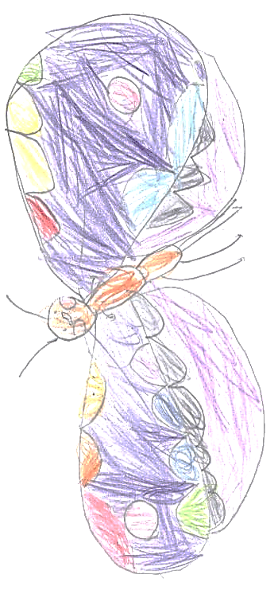
Key take‑aways:
return value couple callers to callee.
Python already offers return‑less solution:
side‑effects & events
exceptions
yield statement, generators and coroutines
Choose the pattern properly – and know when to fall back to return.

Slide 49

Try it yourself at home
Pick one helper that only mutates state
Find the return line
Add log line instead
See which tests really break

Slide 50


Thank for your attention!
The time to yield questions and return answers.
Maxim Danilov
maxim@wpshop.at
Mentoring slots available on:
https://adplist.org/mentors/maxim-danilov
Play with code: github.com/danilovmy/europython2025

Slide 51

Additional Resources:
Łukasz Langa - Thinking In Coroutines 2016
David Beazley – “Generator Tricks for Systems Programmers” 2008
Me. “What are you yield from” 2023

